Slide 1
Computer Essentials 8101
Welcome to Computer Essentials section: 340

Slide 2
Contact information
Name: Mike Rezae
Email: rezaem1@algonquincollege.com
Office:
MCSE, MCP, MCT, A+, N+, Cisco CCNA
Network administrator, IBM, Dell

Slide 3
Course objectives
File management
Backup and recovery data
Install virtual machine (VM)
Number conversions
Data representation
Security , anti virus, passwords
Boolean logic
Hardware (CPU)
Basic networking

Slide 4
Course review
Two hours of lecture per week (Room T321)
One hours of lab each week (Room T111)
There is approximately 11 lab assignments
Each week, we will complete one lab assignment unless something goes wrong
Each lab is scored out of 10.
Hybrid activities-to be completed outside of class time by the student
Labs
Online quizzes
Video presentations
Reading assignments

Slide 5
Grading scheme
Two Mid-Term Tests (45%)
Midterm 1 – Multiple Choice –20% of your final mark
Midterm 2 – Multiple Choice and Short Answer – 25% of your final mark
One Final Exam (30%)
To be held during the month of – December ?
Weekly Lab Assignments (20%)
There will be approximately 11 Labs – one per week
Hybrid Assignments 5%
Each lab is scored out of 10.

Slide 6
Note
If you miss either part of the midterm or the final exam for any reason, no catch up or make up test or exam will be given.
After Week 2 - Lab assignments that are submitted more than one week late will receive a grade of 0.

Slide 7

Text book
Textbook: The Essentials of Computer Organization& Architecture 4th edition by Linda Null and Julia Labor
Available as an e-textbook – it’s now available for download.

Slide 8
Miscellaneous
Do not miss the labs
No late lab acceptable (after one week)
I take the attendance every week
To pass this course you should get 50% of each section, including labs, midterms and final exam
No drink in the lab class (T111)
Check you marks on BB every week
If you need extra help please let me know
Documents should submitted in MS doc, docx ,other format won’t be marked
Do NOT send your lab assignment to my email.

Slide 9
Prior Learning Assessment and Recognition (PLAR)
PLAR is a process that evaluates learning you have gained from life and work experience
Assessment fee of approximately $119 (?)
For this course a PLAR consists of:
A multiple choice test covering all the material in the course similar to a final exam
A possible interview
A possible assignment covering all the material in the course
PLAR Administrator: (613) 727-4723 x 7027 plar@algonquincollege.com Room C222 - Woodroffe Campus

Slide 10
Type of Laptop Required for this Program
Your laptop must meet or exceed the following specifications.
Intel Core i5 or equivalent processor
Minimum 12 GB of RAM
256GB HD
12 inch screen**
1 full size USB port
Wireless 802.11 **
Windows 7 or newer 64 Bit OS

Slide 11
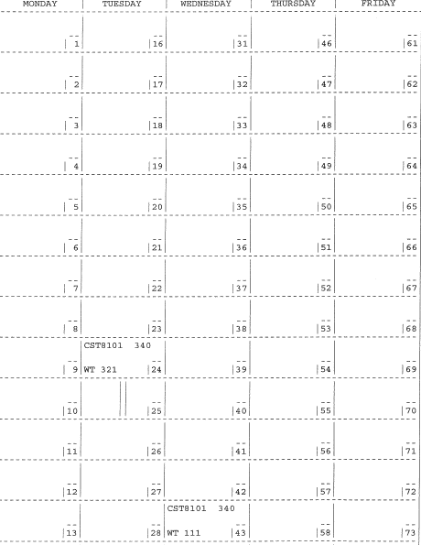
My Schedules

Slide 12
Questions?
Your turn !

